Slide 1
Image Gallery
TIW project 2021/2022
Laura Puccioni (10703762)
JavaScript version

Slide 2
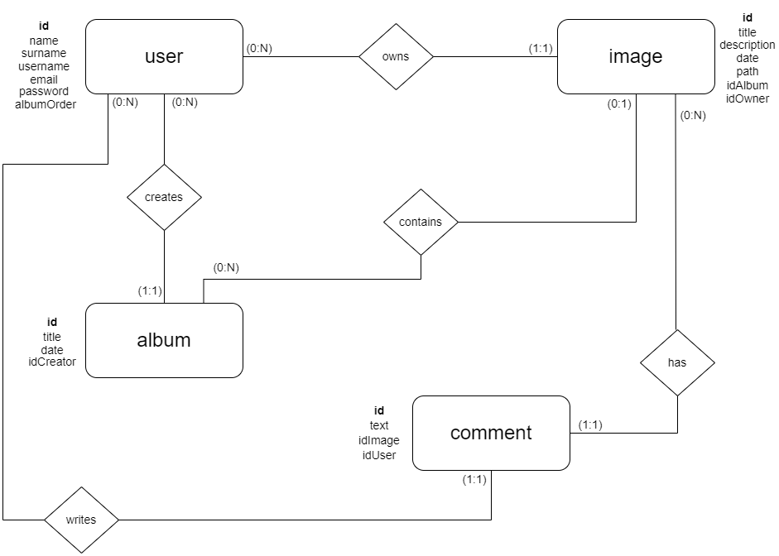

Slide 3
Local database schema
CREATE TABLE ‘user’ (
‘id’ int NOT NULL AUTO_INCREMENT,
‘name’ varchar(200) NOT NULL,
‘surname’ varchar(200) NOT NULL,
‘username’ varchar(200) NOT NULL,
‘email’ varchar(200) NOT NULL, ‘password’ varchar(50) NOT NULL,
‘albumOrder’ varchar(255) DEFAULT NULL,
PRIMARY KEY (‘id’))
UNIQUE INDEX `username_UNIQUE` (`username` ASC) VISIBLE),
UNIQUE INDEX `email_UNIQUE` (`email` ASC) VISIBLE);
CREATE TABLE ‘album’ (
‘id’ INT NOT NULL AUTO_INCREMENT, ‘title’ VARCHAR(200) NOT NULL,
‘date’ DATE NOT NULL,
‘idCreator’ INT NOT NULL,
PRIMARY KEY (‘id’),
CONSTRAINT ‘creator_album’ FOREIGN KEY (‘idCreator’) REFERENCES ‘db_tiw_exam’.’user’ (‘id’) ON DELETE CASCADE ON UPDATE CASCADE);

Slide 4
CREATE TABLE ‘image’ (
‘id’ INT NOT NULL AUTO_INCREMENT, ‘title’ VARCHAR(200) NOT NULL, ‘description’ TEXT NOT NULL,
‘date’ DATE NOT NULL,
‘path’ VARCHAR(255) NOT NULL, ‘idOwner’ INT NOT NULL,
‘idAlbum’ INT DEFAULT NULL,
PRIMARY KEY (‘id’),
UNIQUE INDEX `path_UNIQUE` (‘path’ ASC) VISIBLE,
CONSTRAINT ‘owner_of_image’ FOREIGN KEY (‘idOwner’) REFERENCES ‘db_tiw_exam’.’user’ (‘id’) ON DELETE CASCADE ON UPDATE CASCADE);
CONSTRAINT ‘album_of_image’ FOREIGN KEY (‘idAlbum’) REFERENCES ‘db_tiw_exam’.’album’ (‘id’) ON DELETE SET NULL ON UPDATE CASCADE);
CREATE TABLE ‘comment’ (
‘id’ INT NOT NULL AUTO_INCREMENT, ‘text’ TEXT NOT NULL,
‘idImage’ INT NOT NULL,
‘idUser’ INT NOT NULL,
PRIMARY KEY (‘id’),
CONSTRAINT ‘image_comment’ FOREIGN KEY (‘idImage’) REFERENCES ‘db_tiw_exam’.’image’ (‘id’) ON DELETE CASCADE ON UPDATE CASCADE,
CONSTRAINT ‘user_comment’ FOREIGN KEY (‘idUser’) REFERENCES ‘db_tiw_exam’.’user’ (‘id’) ON DELETE CASCADE ON UPDATE CASCADE);

Slide 5
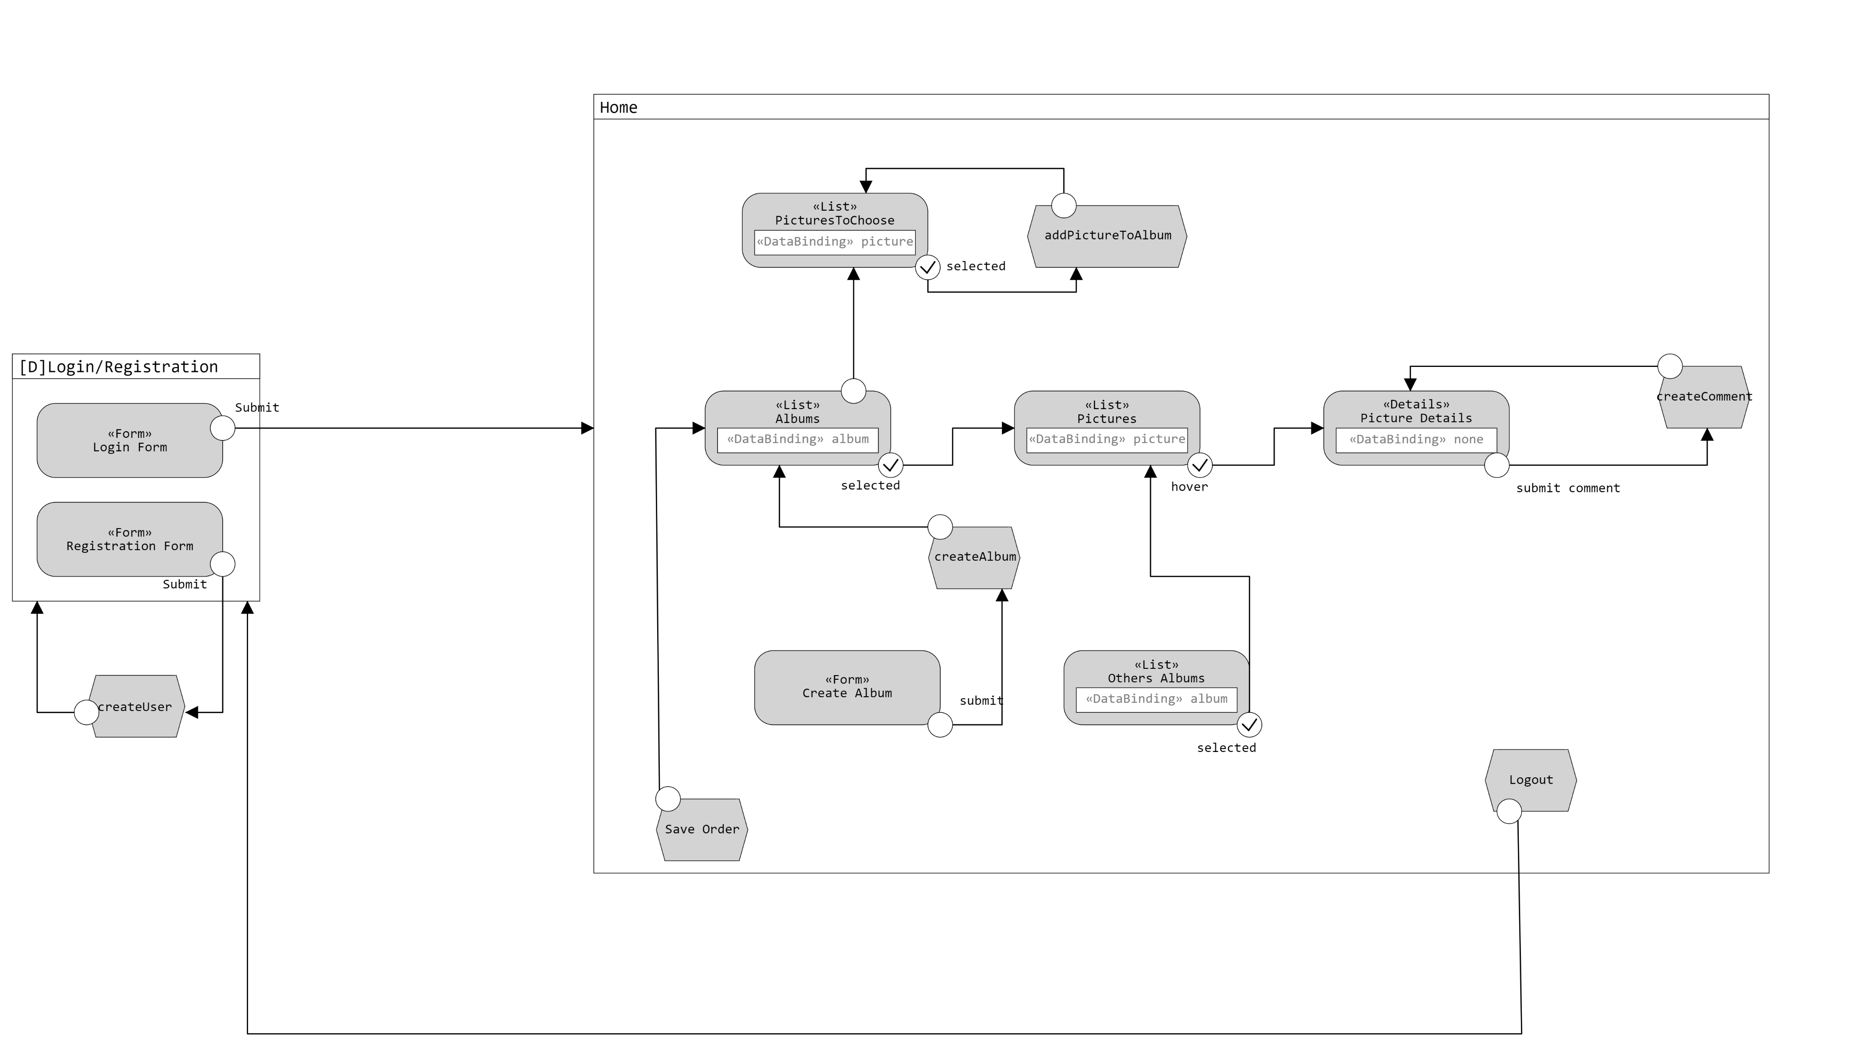
Application Design

Slide 6
Components (javaScript version)
Model Objects (Beans)
Album
Comment
Image
User
Views
index.html
Home.html
Utils
ConnectionHandler
TransformJson
Controllers (Servlets)
CheckLogin
Registration
GetAlbumsList
CreateAlbum
CreateComment
AddPictureToAlbum
GetOthersAlbums
GetPictureDetails
GetPictures
SaveOrder
ShowPicturesToAdd
Logout
DAO
imageDAO
albumDAO
commentDAO
userDAO

Slide 7
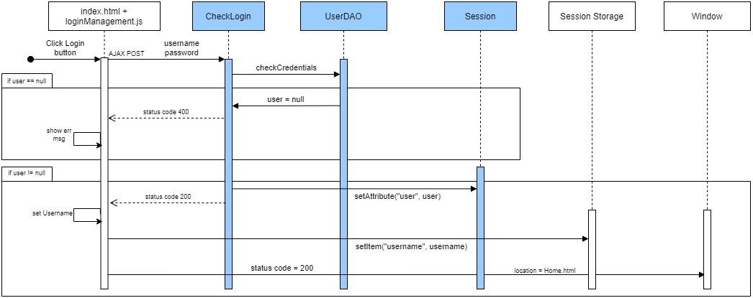
Event : login

Slide 8
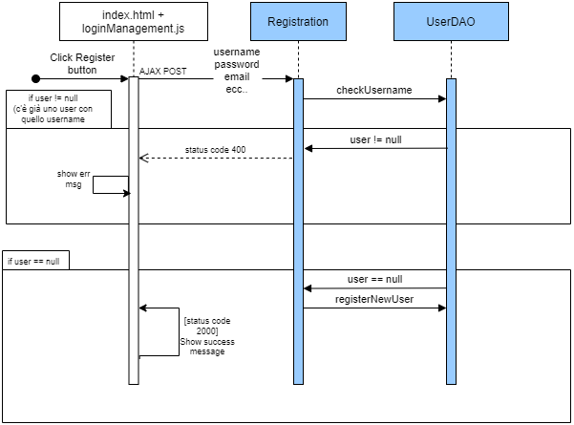
Event: registration

Slide 9
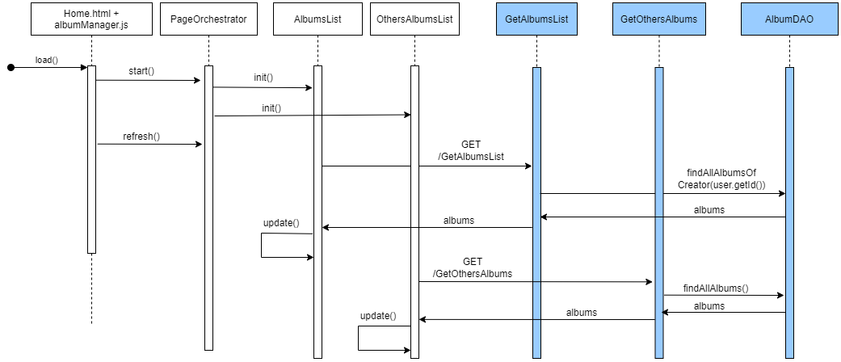
Event: Home Page loading

Slide 10
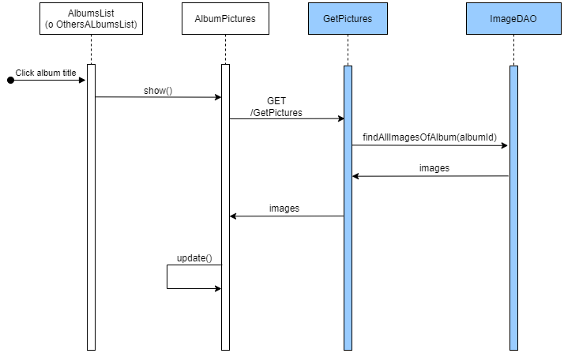
Event: album selection

Slide 11
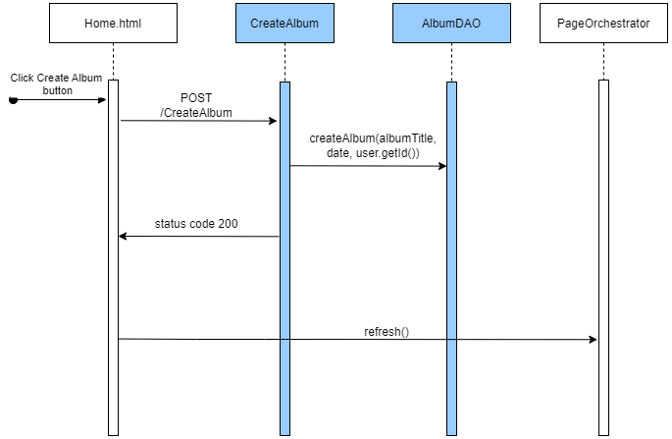
Event: album creation

Slide 12
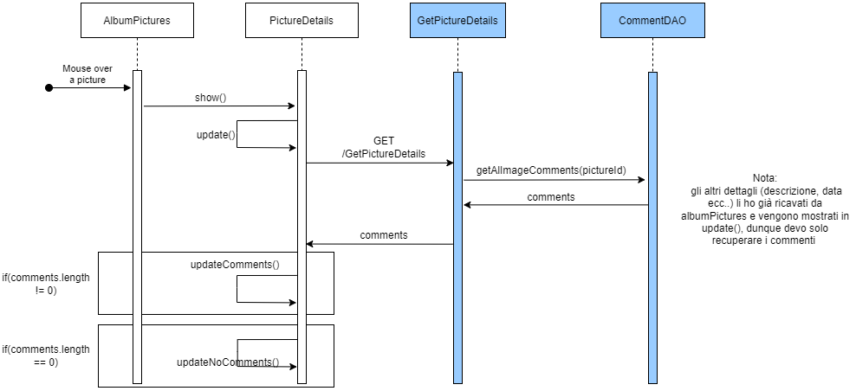
Event: mouse over a picture

Slide 13
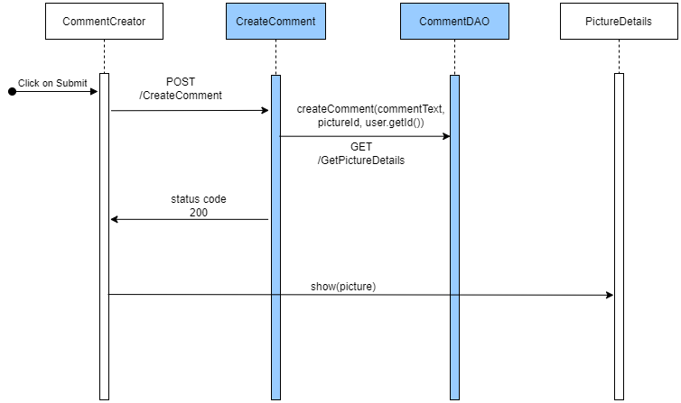
Event: submit a comment

Slide 14
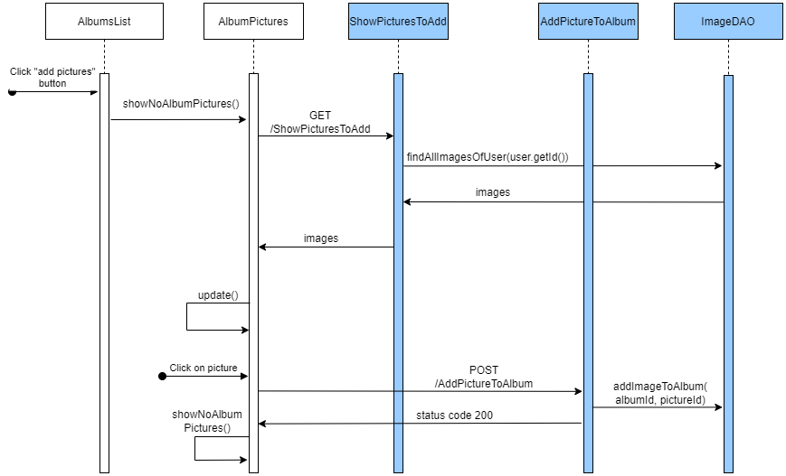
Event: add a picture to album

Slide 15
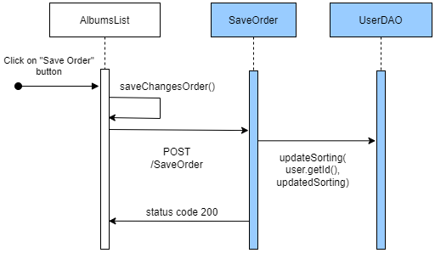
Event: Save Sorting

Slide 16
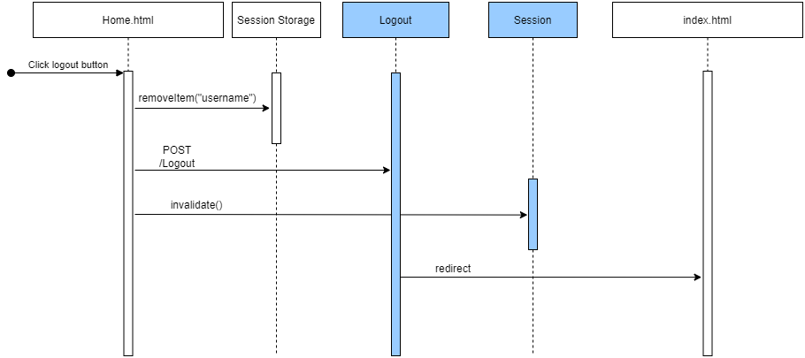
Event: Logout

